Slide 1



CORONA ANALYSIS

Slide 2
Highest number of corona virus is over 4 million on 04-01-2022

Slide 3
In 2020, Cases were less but death toll was high.
In 2022, Cases were high but was not deadly.

Slide 4
As vaccination is increasing death rate is diminishing.

Slide 5
Number of people hospitalised are very less to the number of cases.

Slide 6
High income group has higher cases and death rate is same in
all income groups.

Slide 7
North America and South America has less cases and death rate.

Slide 8
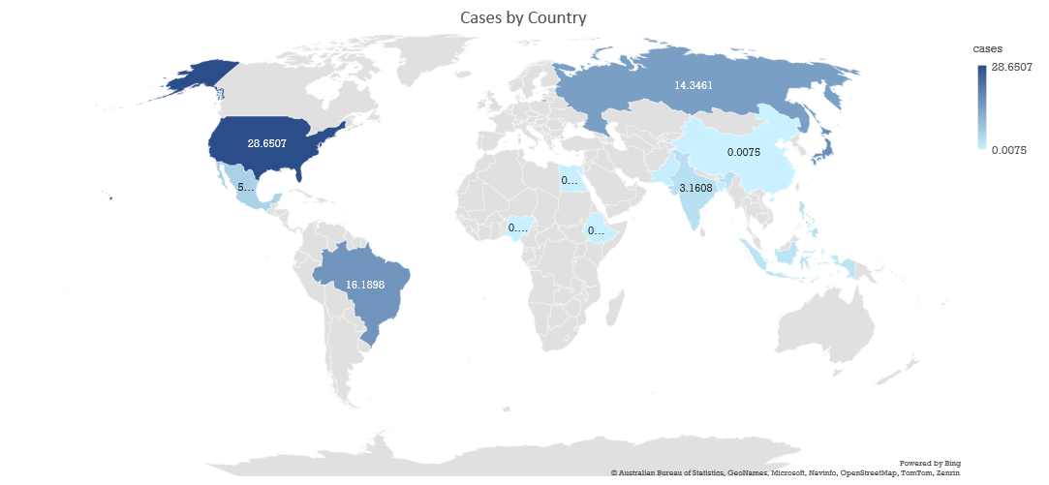
United state has highest spread.
Countries with more than 100M population is considered

Slide 9
All countries have same almost spread irrespective of GDP.
High GDP does not mean less numbers of cases

